Slide 1
Crypto Bot Group - Real Time Crypto Arbitrage Bot
Daniel Abbasi
Erick Garcia
Yuksel Baris Dokuzoglu

Slide 2
Questions to answer
Most open source arbitrage bots require trader input or parametrization to find a narrow field of trades
There is also no machine learning in deciding what is the most profitable strategy
We aim to reduce trader involvement and increase profit finding opportunities
Notes:
ERICK - 2 and 5

Slide 3
Answer
Using the Bellman Ford Algorithm, we were able to identify the best choice of arbitrage strategies and along with currency pairs.
Relies on four scripts:
Kucoinlive:
Websockets real time feed of price data. (Currently only Kucoin)
Trade:
Trading module for execution of arbitrage trades.
Analysis:
actual implementation of ML models.
Reverse and Forward Triangular Arbitrage in analysis.py
Bellman Ford Optimization in bellmanford.py
Features:
Github CICD Pipeline
SQLite implementation
Docker containerization with docker compose
Github Pages Sphinx Documentation
Notes:
Daniel

Slide 4
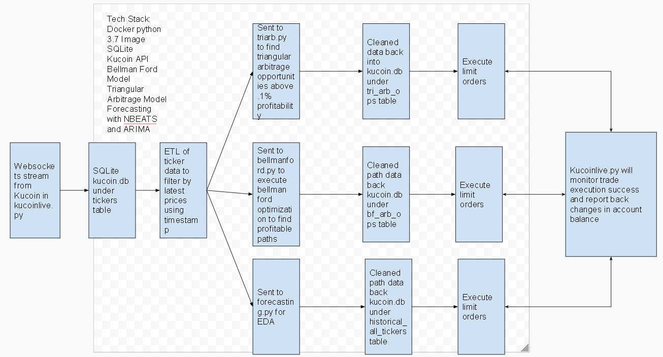
Data Flows for project

Slide 5
Similar Approaches
Most open source arbitrage bots trade between two markets and having it select two pairs in each market.
It requires a yaml configuration file which contains user defined market and pairs parameters. We would like to get rid of the pairs parameters and have multiple models decide profitability.
We decided to compare a triangular arbitrage opportunity github repo and a bellman ford github repo.
Notes:
Daniel

Slide 6
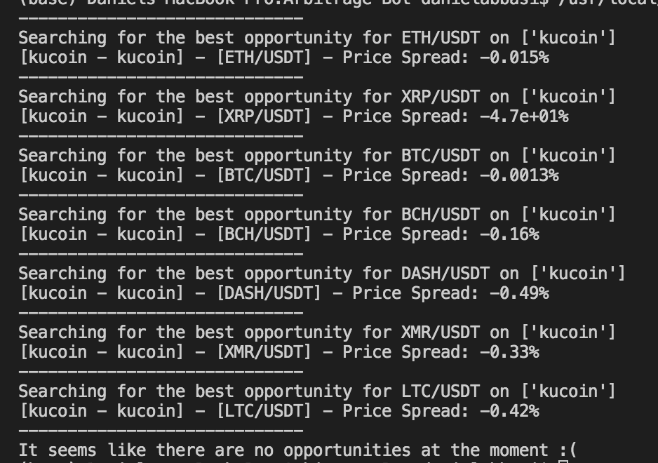
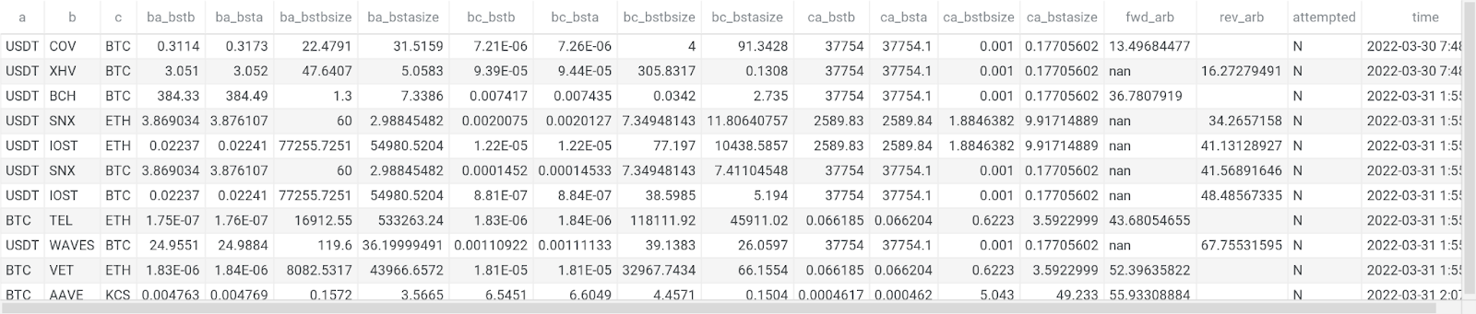
Result Comparison - Triangular Arbitrage
Original: https://github.com/calebpitts/CryptoArbitrageBot
Our Triangular Arbitrage Results
Notes:
Baris

Slide 7
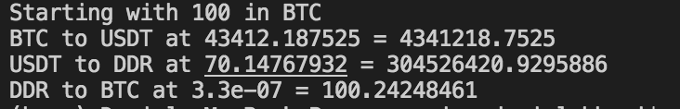
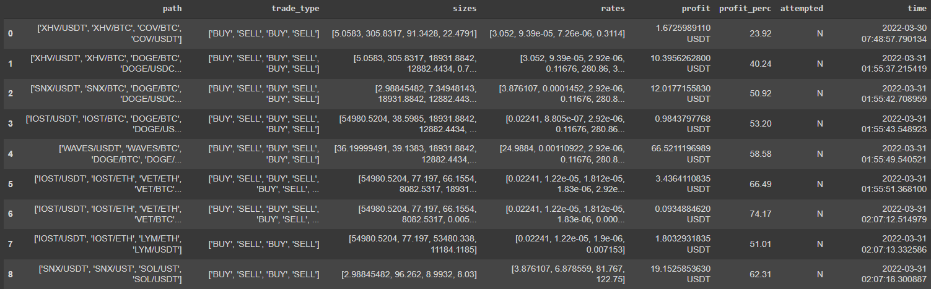
Result Comparison - Bellman-Ford Model
Original: https://github.com/wardbradt/peregrine
Our Bellman Ford Model Results
Notes:
Baris

Slide 8
Performance
Our model found opportunities that were much more profitable than existing open source arbitrage bots. We ran all 3 codebases at the same time and collected results.
The only caveat is that these trades were not executed in a production setting. It was only attempted in a sandbox environment with fake currency.
Codebase | Maximum Percentage Triangular Arbitrage | Maximum Percentage Bellman Ford
Original GitHub repo | 47% spread in XRP/USDT (Did not look like triangular arbitrage even though it claims it is) | .24% BTC/USDT (Shows one path for Kucoin)
Our Code | 67% | 74%
Notes:
Daniel

Slide 9
To Do
Run it through Gemini and Coinbase Pro sandboxes
Kucoin sandbox environment is not tradeable at the moment.
Support multiple exchanges
Trade across multiple exchanges
Notes:
Baris

Slide 10
References
Aloosh, A., & Bekaert, G. (2017). Currency Factors. SSRN Electronic Journal. <https://doi.org/10.2139/ssrn.3022623>
Gębarowski, R., Oświęcimka, P., Wątorek, M., & Drożdż, S. (2019). Detecting correlations and triangular arbitrage opportunities in the Forex by means of multifractal detrended cross-correlations analysis. Nonlinear Dynamics, 98(3), 2349–2364. <https://doi.org/10.1007/s11071-019-05335-5>
<https://github.com/calebpitts/CryptoArbitrageBot>
<https://github.com/JinJis/arbitrage-bot>
<https://github.com/rosshochwert/arbitrage>
<https://github.com/wardbradt/peregrine>
Gradojevic, N., Erdemlioglu, D., & Gençay, R. (2020). A new wavelet-based ultra-high-frequency analysis of triangular currency arbitrage. Economic Modelling, 85, 57–73. <https://doi.org/10.1016/j.econmod.2019.05.006>
Ito, T. (2012, November 15). Free Lunch! Arbitrage Opportunities in the Foreign Exchange Markets. NBER. <https://www.nber.org/papers/w18541>
Knif, J., Pynnönen, S., & Luoma, M. (1995). An analysis of lead-lag structures using a frequency domain approach: Empirical evidence from the Finnish and Swedish stock markets. European Journal of Operational Research, 81(2), 259–270. <https://doi.org/10.1016/0377-2217(93)e0321-n>

Slide 11
References
Lin, A., Shang, P., & Zhao, X. (2011). The cross-correlations of stock markets based on DCCA and time-delay DCCA. Nonlinear Dynamics, 67(1), 425–435. <https://doi.org/10.1007/s11071-011-9991-8>
MacKenzie, D. (2016). A material political economy: Automated Trading Desk and price prediction in high-frequency trading. Social Studies of Science, 47(2), 172–194. <https://doi.org/10.1177/0306312716676900>
Mushailov, J. (Iosif). (2021, March 31). LSTM Framework For Univariate Time-Series Prediction. Medium. https://towardsdatascience.com/lstm-framework-for-univariate-time-series-prediction-d9e7252699e
Piccotti, L. R. (2018). Jumps, cojumps, and efficiency in the spot foreign exchange market. Journal of Banking & Finance, 87, 49–67. <https://doi.org/10.1016/j.jbankfin.2017.09.007>
What Is Triangular Arbitrage? (2021, November 8). Investopedia. <https://www.investopedia.com/terms/t/triangulararbitrage.asp>
<https://github.com/Kucoin/kucoin-python-sdk/issues/33>

